Slide 1
AI Lab 2 - Search

Slide 2
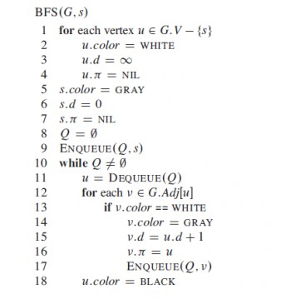
Recall BFS
Can you implement it now using Python?
Give it a try! Here is the pseudocode.
4
0
1
3
2

Slide 3
A Few More Python Concepts
Deep Copy
Shallow Copy
The del operator
It will delete the object (actually Python’s garbage collector will perform the deletion)
But there must be no other references to the object

Slide 4
Let’ see a different kind of BFS
But first let’s try to solve a problem!

Slide 5
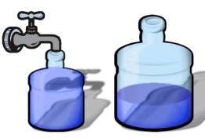
The Jugs Puzzle
We are given 2 jugs, a 4 liter(x L) one and a 3 liter(y L) one. Neither has any measuring markers on it. A pump can be used to fill the jugs with water. How can we get exactly 2(z L) liters of water into any of the jugs?
3L
4L

Slide 6
Problem Solving Agent
We are going to develop an agent.
The agent will perform a sequence of actions.
Will try to reach the goal. (2L in one of the bottles)

Slide 7
Characteristics of the Problem Solving Agent
Problem Formulation:
Define State –limited
Define the actions– limited
Goal Formulation
Environment Characteristics:
Observable – the agent knows
Discreet – Finite no of states
Deterministic – one action, one state

Slide 8
Search Problem Characteristics
Initial State – (0,0)
Actions Set –
Empty left
Empty Right
Fill Left
Fill Right
Transfer from left to right
Transfers from right to left

Slide 9
Search Problem Charactersitics
Transition Model -
(0,0)-----fill left--🡪 (3,0)
Goal Test –
isGoal(2,4)-> True
isGoal(1,1) ->False
Path Cost – The cost of each action taken

Slide 10
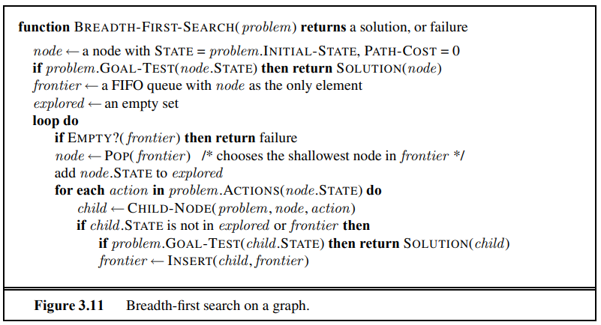

Slide 11
Previous BFS vs Current BFS

Slide 12
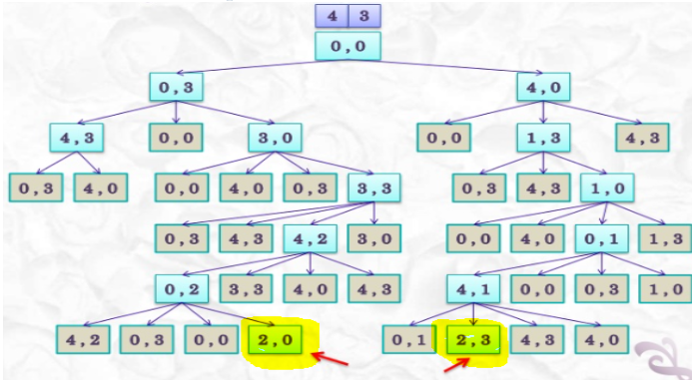
State Map

Slide 13
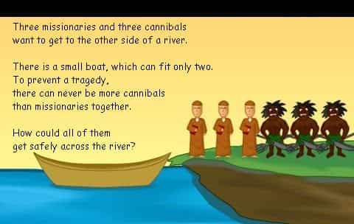
The Missionaries and Cannibals Problem

Slide 14
The Missionaries and Cannibals Problem
Try playing the following game - link

Slide 15
The Missionaries and Cannibals Problem
Now let us develop a program to solve this problem

Slide 16
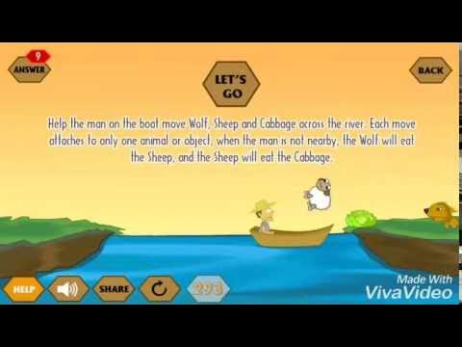
Try to Solve this Yourselves
Click here to play the game

Slide 17
Thank You

